Slide 1
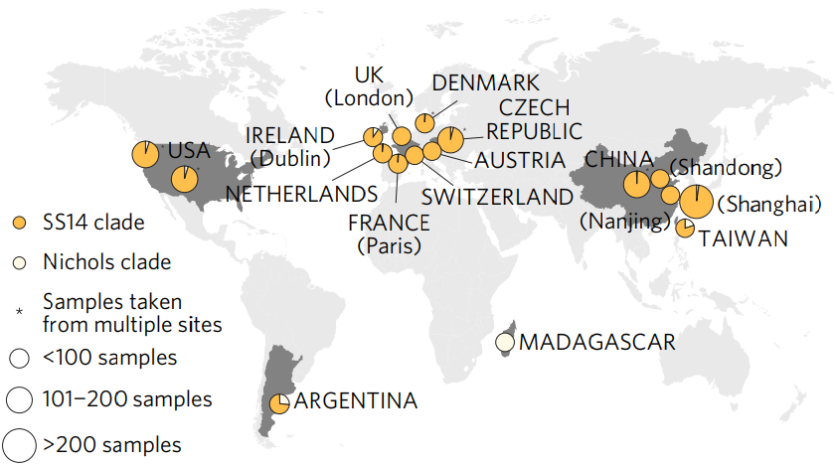
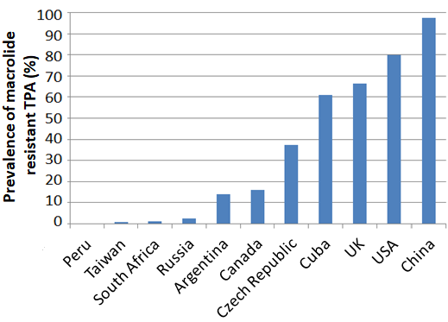
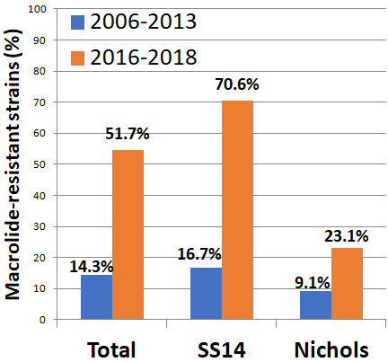
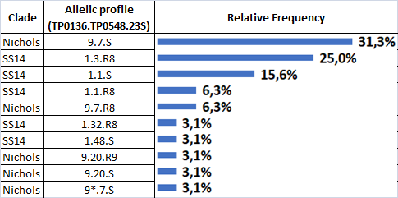
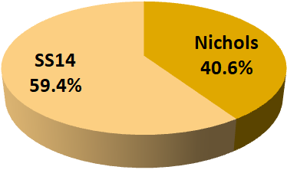
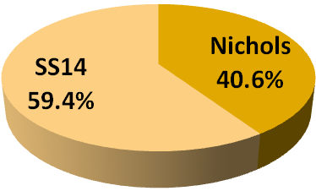
Dramatic Increase Of Macrolide Resistance In Treponema Pallidum
Isolates In Argentina
N. Morando*¹, E. Vrbova², A. Melgar³, R.D. Rabinovich¹, D. Šmajs², M.A. Pando¹
¹Instituto de Investigaciones Biomédicas en Retrovirus y SIDA, Buenos Aires, Argentina,
² Masaryk University, Department of Biology, Brno, Czech Republic, ³Universidad de Buenos Aires, Hospital de Clínicas “José de San Martín”, PETS
Background
Globally, approximately 94% of Treponema pallidum (TPA) clinical isolates belong to the SS14-like group, 6% belong to the Nichols-like group and macrolide resistance ranges from 0 to 100%. A previous study by our group (Gallo Vaulet et al. 2018) revealed that Argentina has a different distribution pattern with a higher frequency of Nichols-like strains (26.8%) and low levels of macrolide resistance (14.3%). Several studies suggested that the molecular epidemiology of TPA is changing, so our goal was to update the information on circulating TPA strains in order to assess strain distribution and macrolide resistance frequency in Buenos Aires.
Global distribution of T.pallidum strains SS14-like and Nichols-like (Arora et al. 2016)
Reported macrolide resistance in T. pallidum worldwide
Methods
Swab samples from patients with clinical symptoms of syphilis were collected during 2016-2018. DNA was isolated and three loci (TP0136, TP0548, 23S rRNA) were characterized by sequencing-based typing. Strains were classified into two clades based on similarity to reference sequences: Nichols-like and SS14-like. We determined the presence of macrolide resistance-associated mutations (A2058G, A2059G) by examination of the 23S rRNA gene sequence. The distribution of allelic profiles was based on combinations of TP0136, TP0548 and 23S rRNA sequences. Analyses were performed using Fisher´s exact test (IBM SPSS Statistics Base 22.0).
Among 32 swab samples 40.6% were classified as Nichols-like and 59.4% as SS14-like.
Macrolide resistance prevalence was found to be 51.7%, being significantly more frequent among SS14-like samples as compared with Nichols-like samples (70.6% (12/17) vs. 23.1% (3/12), respectively; p=0.0253).
Results
Ten distinct allelic profiles were found, five related to the SS14 strain and five related to the Nichols strain.
Compared to a previously published study (samples collected in the same setting between 2006-2013, n=41), macrolide resistance significantly increased (51.7% vs. 14.3%, p=0.0012) between the studies.
The frequency of Nichols-like strains increased compared to the previous study
(26.8% vs. 40.6%, p=0.31).
S: susceptible; R8: resistant (A2058G); R9: resistant (A2059G);
9*: new TP0136 allele, related to allele 9
Conclusions
Even though macrolide resistance isolates were previously detected at a relatively low frequency in Argentina, our results reveal a dramatic increase. Our results are in agreement with international tendencies and underscore the need to pursue further TPA molecular typing studies in Argentina and Latin America.
PRESENTED AT THE 23RD INTERNATIONAL AIDS CONFERENCE (AIDS 2020) | 6-10 JULY 20203
*nicolasmorando94@gmail.com

